Slide 1
Regression & Forecasting
HDA Workshop
Khawar Naveed Bhatti, MBA Lecturer in Operational Research & Business Analytics

Slide 2
Lecture Outline
Introduction to time-series forecasting
Linear Equations
Simple linear regression
Excel functions (slope, intercept, trend)
Data Analysis ToolPak
Interpreting regression statistics
Multiple linear regression

Slide 3
Forecasting
Planning for the future is an essential aspect of managing any organization
Efficient and accurate predictions can make the difference between success and failure
Government
Unemployment, inflation, industrial production
Retailing Corporation
Product demand, consumer preferences, sales revenues, inventory
University Administration
Student enrolments, trends in curricula

Slide 4
Forecasting techniques
Managers require good forecasts of future events.
Business Analysts may choose from a wide range of forecasting techniques to support decision making.
Three major categories of forecasting approaches:
1. Qualitative and judgmental techniques
2. Statistical time-series models
3. Explanatory/causal models

Slide 5

Time-series forecasting
Time-series
Set of observations on a variable measured over successive periods of time
E.g., sales each quarter over the last three years
Assumptions
The past is a good guide to the future
Main drivers in the past will continue in the future
Objective of time-series analysis
Discover patterns in the historical data
Extrapolate this pattern into the future

Slide 6
Time-series forecasting
Time-series
Set of observations on a variable measured over successive periods of time
E.g., sales each quarter over the last three years
Assumptions
The past is a good guide to the future
Main drivers in the past will continue in the future
Objective of time-series analysis
Discover patterns in the historical data
Extrapolate this pattern into the future

Slide 7
Sketch the line 2x – y = 4
Y
First pt: choose x = 0
→ y = 2(0) – 4 = – 4
Second pt: choose y = 0
→ 2x – 4 = 0 → x = 2
O
X
Plot pt (0,-4)
Plot pt (2, 0)
Join Points

Slide 8
Straight Line: slope-intercept form
General form: ax + by = c
Slope-intercept form y = mx + k
where
k is the intercept on the y axis
m is the slope
Example: General: 2x – y = 4
Slope-intercept: y = 2x - 4

Slide 9
Graphs of Linear Equations
y = 2x – 4
k = - 4
m = 2
Y
O
X
-4

Slide 10
Graphs of Linear Equations
y = -2x + 4
k = 4
m = -2
Y
4
O
X

Slide 11
Inferential statistics
Descriptive statistics is about summarising data
Inferential statistics is about using data to make predictions
We’re trying to infer based on the data we’ve got
Common types of inferential statistical methods include:
Hypothesis testing (e.g. comparing means)
Confidence intervals
Correlation analyses
Regression

Slide 12
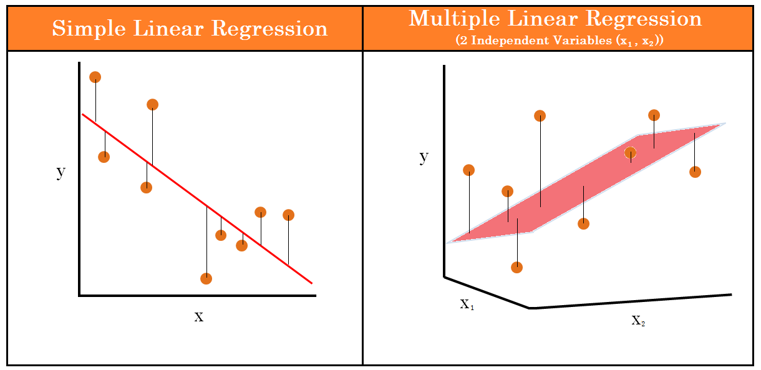
Regression Analysis
Regression analysis is a tool for building mathematical and statistical models that characterize relationships between a dependent variable and one or more independent, or explanatory variables, all of which are numerical.
Simple linear regression involves a single independent variable.
Multiple regression involves two or more independent variables.
Notes:
In statistical modeling, regression analysis is used to estimate the relationships between two or more variables:
Dependent variable (aka criterion variable) is the main factor you are trying to understand and predict.
Independent variables (aka explanatory variables, or predictors) are the factors that might influence the dependent variable.

Slide 13
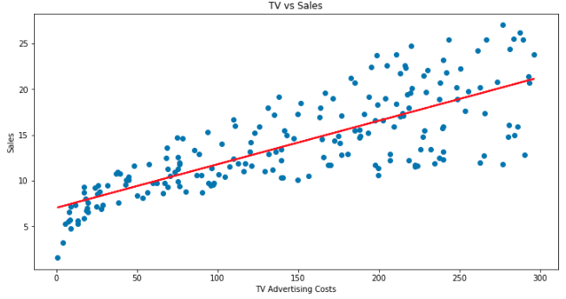
Regression Analysis
Allows you to predict what a value of interest will be, given a set of explanatory inputs
Often used in business to evaluate trends and make estimates or forecasts
Estimating sales based on price and or advertising expenditures
Estimating health insurance claims based on age

Slide 14
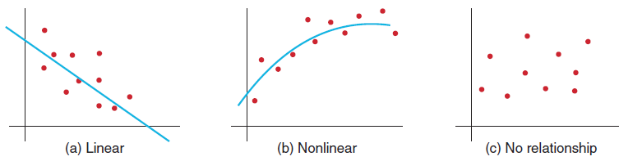
Simple Linear Regression
Finds a linear relationship between:
- one independent variable X and
- one dependent variable Y
First prepare a scatter plot to verify the data has a linear trend.
Use alternative approaches if the data is not linear.

Slide 15
Simple Linear Regression
Specifically, given a set of inputs X and outputs Y, our aim is to determine the intercept b₀ and slope b₁ of the linear equation:
y = b₀ + b₁ x
Dependent variable
Independent variable
Intercept
Slope

Slide 16
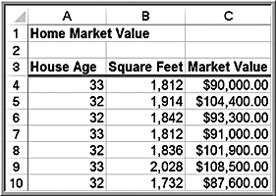
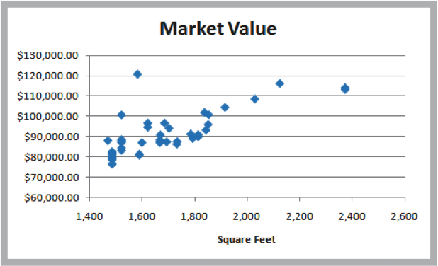
Example: Home Market Value Data
Size of a house is typically related to its market value.
X = square footage
Y = market value ($)
The scatter plot of the full data set (42 homes) indicates a linear trend.

Slide 17
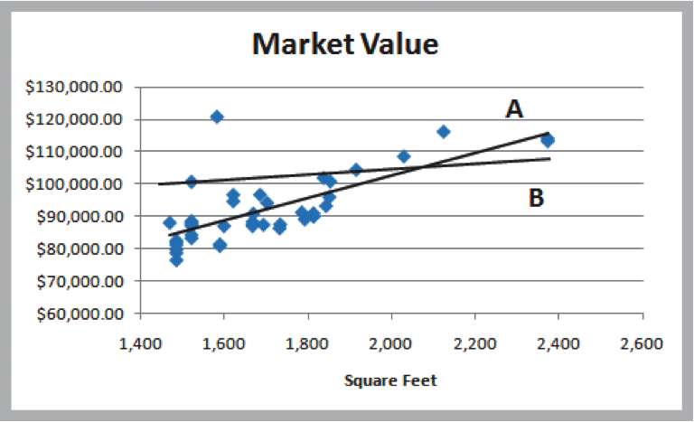
Finding the Best-Fitting Regression Line
Market value = b₀ + b₁ × square feet
Two possible lines are shown below.
Line A is clearly a better fit to the data.
We want to determine the best regression line.

Slide 18
Fitting the line
To find the best intercept b₀ and slope b₁, we want to minimise the distance between the line and the set of points
The distance between the line and the point is called the error (or residual)
Error
Error

Slide 19
Finding the slope and intercept
The typical procedure for finding the line of best fit is called the method of least-squares
Basic steps:
Compute the error for each data point
Square the error
Add all the squared errors together
Adjust parameters b₀ and b₁ to make total squared error as small as possible
The best-fitting line minimizes the sum of squares of the residuals.

Slide 20
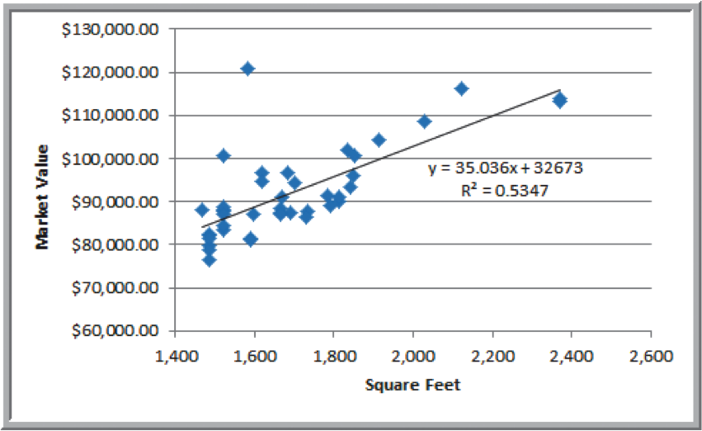
Find the Best Regression Line with Excel
Market value = 32,673 + $35.036 × square feet
The estimated market value of a home with 2,200 square feet would be: market value = $32,673 + $35.036 × 2,200 = $109,752
The regression model explains variation in market value due to size of the home.
It provides better estimates of market value than simply using the average.

Slide 21
Linear regression with Excel
Options for doing simple regression in Excel include …
Trendline
Excel functions:
=INTERCEPT(known_y’s, known_x’s)
=SLOPE(known_y’s, known_x’s)
=TREND(known_y’s, known_x’s, new_x)
Analysis ToolPak
A good start for beginners
As with Descriptive Statistics, doesn’t update automatically given changes in the data

Slide 22
Using Excel Functions to Find Least-Squares Coefficients
Slope = b₁ = 35.036
=SLOPE(C4:C45, B4:B45)
Intercept = b₀ = 32,673
=INTERCEPT(C4:C45, B4:B45)
Estimate Y when X = 1750 square feet
Y = 32,673 + 35.036(1750) = $93,986
=TREND(C4:C45, B4:B45, 1750)

Slide 23
Analysis ToolPak
To load the Analysis ToolPak
Select File → Options -> Add-Ins
In the Manage box at the bottom select “Excel Add-ins” then click “Go”
Check the “Analysis ToolPak” and hit “OK”
Once loaded, click Data Analysis under the Data tab

Slide 24
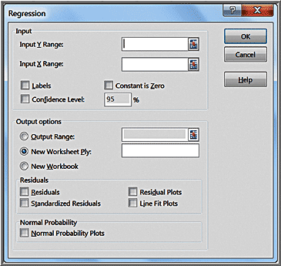
Simple Linear Regression With Excel
Data > Data Analysis >
Regression
Input Y Range (with header)
Input X Range (with header)
Check Labels
Excel outputs a table with many useful regression statistics.

Slide 25
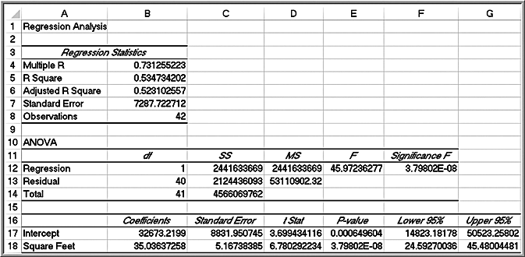
Results Home Market Value Regression

Slide 26
Regression Statistics
Multiple R – another name for the sample correlation coefficient r.
The value of r varies from -1 to +1 (r is negative if slope is negative).
A value of 0 indicates no correlation.
R Square - coefficient of determination, R ²
The value of R ² varies from 0 (no fit) to 1 (perfect fit).
R ² gives the proportion of variation in the dependent variable that is explained by the independent variable
Adjusted R Square - adjusts R ² for sample size and number of X variables
Standard Error - variability between observed and predicted Y values. This is formally called the standard error of the estimate, S_{YX}.

Slide 27
Interpreting Regression Statistics for Simple Linear Regression
53% of the variation in home market values can be explained by home size.
The standard error of $7287 is less than standard deviation (not shown) of $10,553.

Slide 28
Interpreting Hypothesis Tests for Regression Coefficients
The p-value of the slope (square feet) is equal to the Significance F value.
This is true when there is only one independent variable because it is the only explanatory variable.
Use p-values to draw conclusion
Neither coefficient is statistically equal to zero.

Slide 29
Multiple linear regression
In multiple linear regression, we use multiple independent variables to predict the dependent variable
Again, assume a linear relationship between inputs and outputs
Specifically, given a set of outputs Y and a set of n input values X₁, X₂, … X_{n}, our aim is determine the parameters b₀, b₁, …, b_{n} of the linear equation:
y = b₀ + b₁ x₁ + … + b_{n} x_{n}

Slide 30
Estimated Multiple Regression Equation
The regression coefficients b₀, b₁, b₂,… b_{n}, are called partial regression coefficients
The partial regression coefficients represent the expected change in the dependent variable when the associated independent variable is increased by one unit while the values of all other independent variables are held constant.

Slide 31
Excel Regression Tool
The independent variables in the spreadsheet must be in contiguous columns.
So, you may have to manually move the columns of data around before applying the tool.
Multiple R and R Square are called the multiple correlation coefficient and the coefficient of multiple determination, respectively, in the context of multiple regression.

Slide 32
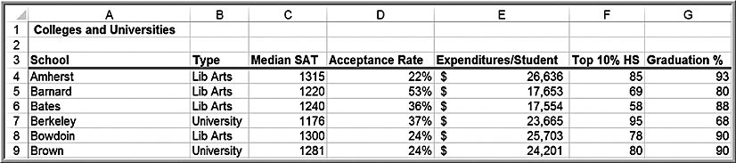
Interpreting Regression Results for the Colleges and Universities Data
Predict student graduation rates using several indicators (median SAT, acceptance rate, expenditure/student, percent in the top of their high school class):

Slide 33
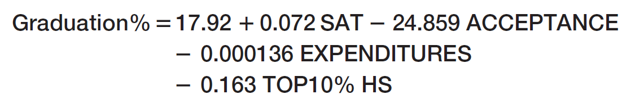
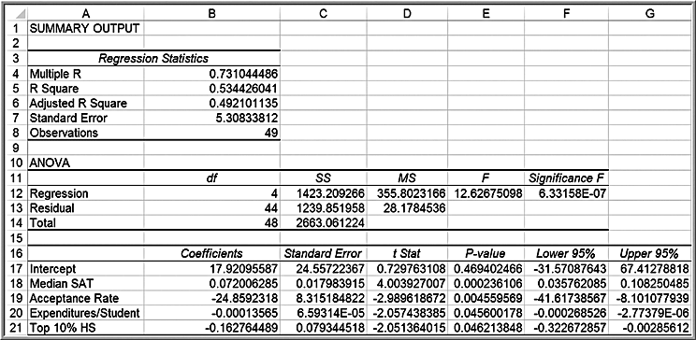
Colleges and Universities Data Continued
Regression model
The value of R² indicates that 53% of the variation in the dependent variable is explained by these independent variables.
All coefficients are statistically significant (p-values < 0.05).

